Slide 1
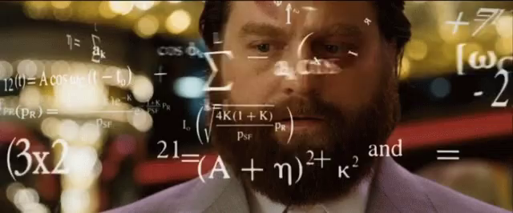
CAPSTONE
DSIR 14
Alex Jacob
Notes:
The picture I think manages to portray as to how confusing it is when the world literally is your oyster

Slide 2


IDEA NUMERO UNO:
Notes:
DATA IS EVERYWHERE
So that’s the hard put figuring out one segment and dialing into it So I’ve decided to center on 2 very different industries, and do something along the lines of data from *INSERT*
OR
Data from *Insert*

Slide 3

1.) Season trend analysis of sounds used within ‘pop’ songs- essentially allowing to quantify the variables within pop song
2.)Mimic creating a ‘discover weekly’ algorithm

Slide 4
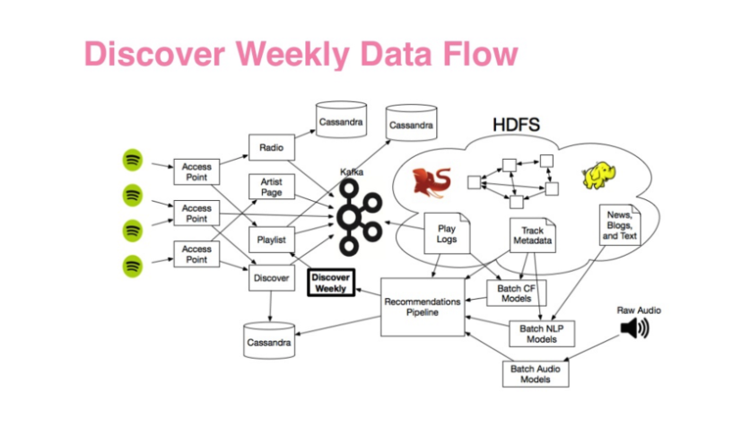
1.) Season trend analysis of sounds used within ‘pop’ songs- essentially allowing to quantify the variables within pop song 2.)Mimic creating a ‘discover weekly’ algorythym
Notes:
Seasonal- adjust accordingly based off billboard top 100, and the reason am using ‘pop’ songs as for specific genres it would be far more difficult to differentiate the subtleties between songs
Inspired by the practice project, however might be a bit hard
2- do you guys know what that is?

Slide 5

IDEA NUMERO DUO
-correlation regarding market fluctuations & Elon Musk tweets

